Slide 1
Inheritance

Slide 2
The general form of a class declaration that inherits a superclass is shown here:
class subclass-name extends superclass-name {
// body of class
}

Slide 3
// A simple example of inheritance.
// Create a superclass.
class A {
int i, j;
void showij() {
System.out.println("i and j: " + i + " " + j);
}
}
// Create a subclass by extending class A.
class B extends A {
int k;
void showk() {
System.out.println("k: " + k);
}
void sum() {
System.out.println("i+j+k: " + (i+j+k));
}
}

Slide 4
A Superclass Variable Can Reference a Subclass Object
class RefDemo {
public static void main(String args[]) {
BoxWeight weightbox = new BoxWeight(3, 5, 7, 8.37);
Box plainbox = new Box();
double vol;
vol = weightbox.volume();
System.out.println("Volume of weightbox is " + vol);
System.out.println("Weight of weightbox is " + weightbox.weight);
System.out.println();
// assign BoxWeight reference to Box reference
plainbox = weightbox;
vol = plainbox.volume(); // OK, volume() defined in Box
System.out.println("Volume of plainbox is " + vol);
/* The following statement is invalid because plainbox
does not define a weight member. */
// System.out.println("Weight of plainbox is " + plainbox.weight);
}
}

Slide 5
Using super
Whenever a subclass needs to refer to its immediate superclass, it can do so by use of the keyword super.
super has two general forms:
calls the superclass’ constructor
to access a member of the superclass that has been hidden by a member of a subclass.

Slide 6
Using super to Call Superclass Constructors
A subclass can call a constructor defined by its superclass by
super(arg-list);
// BoxWeight now uses super to initialize its Box attributes.
class BoxWeight extends Box {
double weight;
BoxWeight(double w, double h, double d, double m) {
super(w, h, d); // call superclass constructor
weight = m;
}
}

Slide 7
Second Use for super
super.member
member can be either a method or an instance variable.

Slide 8
// Using super to overcome name hiding.
class A {
int i;
}
// Create a subclass by extending class A.
class B extends A {
int i; // this i hides the i in A
B(int a, int b) {
super.i = a; // i in A
i = b; // i in B
}
void show() {
System.out.println("i in superclass: " + super.i);
System.out.println("i in subclass: " + i);
}
}

Slide 9
class UseSuper {
public static void main(String args[]) {
B subOb = new B(1, 2);
subOb.show();
}
}
This program displays the following:
i in superclass: 1
i in subclass: 2

Slide 10
Method Overriding
// Method overriding.
class A {
int i, j;
A(int a, int b) {
i = a;
j = b;
}
// display i and j
void show() {
System.out.println("i and j: " + i + " " + j);
}
}

Slide 11
class B extends A {
int k;
B(int a, int b, int c) {
super(a, b);
k = c;
}
// display k – this overrides show() in A
void show() {
System.out.println("k: " + k);
}
}

Slide 12
class B extends A {
int k;
B(int a, int b, int c) {
super(a, b);
k = c;
}
void show() {
super.show(); // this calls A's show()
System.out.println("k: " + k);
}
}

Slide 13
Dynamic Method Dispatch
// Dynamic Method Dispatch
class A {
void callme() {
System.out.println("Inside A's callme method");
}
}
class B extends A {
// override callme()
void callme() {
System.out.println("Inside B's callme method");
}
}
class C extends A {
// override callme()
void callme() {
System.out.println("Inside C's callme method");
}
}

Slide 14
class Dispatch {
public static void main(String args[]) {
A a = new A(); // object of type A
B b = new B(); // object of type B
C c = new C(); // object of type C
A r; // obtain a reference of type A
r = a; // r refers to an A object
r.callme(); // calls A's version of callme
r = b; // r refers to a B object
r.callme(); // calls B's version of callme
r = c; // r refers to a C object
r.callme(); // calls C's version of callme
}
}

Slide 15
Using Abstract Classes
abstract type name(parameter-list);
class that contains one or more abstract methods must also be declared abstract.
abstract class classname{
//body of the class
}

Slide 16
abstract class A {
abstract void callme();
// concrete methods are still allowed in abstract classes
void callmetoo() {
System.out.println("This is a concrete method.");
}
}
class B extends A {
void callme() {
System.out.println("B's implementation of callme.");
}
}
class AbstractDemo {
public static void main(String args[]) {
B b = new B();
b.callme();
b.callmetoo();
}
}

Slide 17
Using final with Inheritance
The keyword final has three uses
to create the equivalent of a named constant
to Prevent Overriding
to Prevent Inheritance

Slide 18
Using final to Prevent Overriding
class A {
final void meth() {
System.out.println("This is a final method.");
}
}
class B extends A {
void meth() { // ERROR! Can't override.
System.out.println("Illegal!");
}
}

Slide 19
Using final to Prevent Inheritance
final class A {
//...
}
// The following class is illegal.
class B extends A { // ERROR! Can't subclass A
//...
}

Slide 20
Packages
Defining a Package
the general form of the package statement:
package pkg;
The general form of a multileveled package statement
package pkg1[.pkg2[.pkg3]];

Slide 21
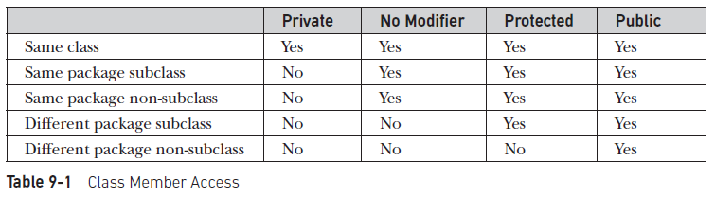
Access Protection

Slide 22
Importing Packages
The general form of the import statement:
import pkg1 [.pkg2].(classname | *);

Slide 23
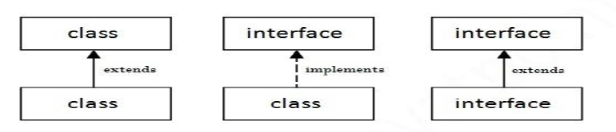
Interfaces

Slide 24
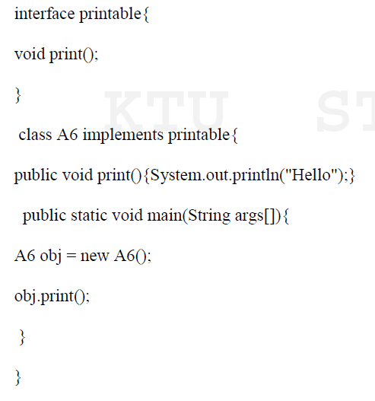

Slide 25
Defining an Interface
access interface name {
return-type method-name1(parameter-list);
return-type method-name2(parameter-list);
type final-varname1 = value;
type final-varname2 = value;
//...
return-type method-nameN(parameter-list);
type final-varnameN = value;
}

Slide 26
Implementing Interfaces
class classname [extends superclass] [implements interface [,interface...]] {
// class-body
}

Slide 27
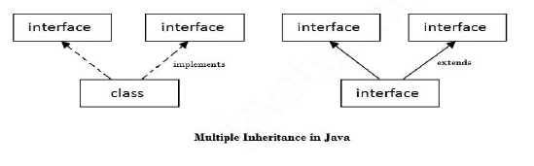
Multiple Inheritance

Slide 28
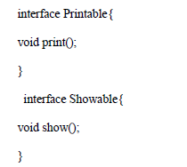

Slide 29
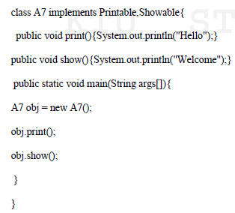

Slide 30
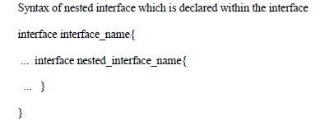
Nested interface

Slide 31



Slide 32
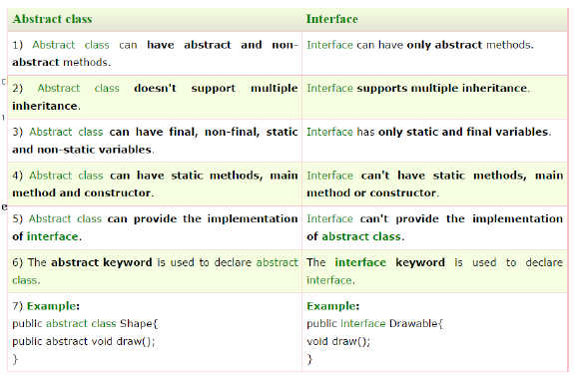

Slide 33
Exception Handling in Java

Slide 34

Types of Java Exceptions

Slide 35
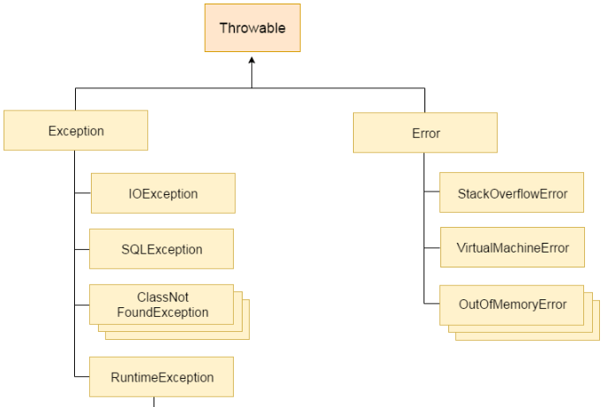
Hierarchy of Java Exception classes

Slide 36
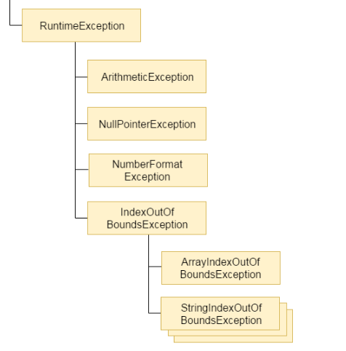

Slide 37
Common Scenarios of Java Exceptions
A scenario where ArithmeticException occurs
int a=50/0;//ArithmeticException
2) A scenario where NullPointerException occurs
String s=null;
System.out.println(s.length());//NullPointe rException
3) A scenario where NumberFormatException occurs
String s="abc";
int i=Integer.parseInt(s);//NumberFormatExce ption

Slide 38
4) A scenario where ArrayIndexOutOfBoundsException occurs
int a[]=new int[5];
a[10]=50; //ArrayIndexOutOfBoundsException

Slide 39
Java Exception Keywords
There are 5 keywords which are used in handling exceptions in Java.
try
catch
finally
throw
throws

Slide 40
Catching Exceptions
The syntax for using try/catch
try {
// Protected code
}
catch (ExceptionName e1) {
// Catch block
}

Slide 41
// File Name : ExcepTest.java
import java.io.*;
public class ExcepTest {
public static void main(String args[]) {
try {
int a[] = new int[2];
System.out.println("Access element three :" + a[3]); }
catch (ArrayIndexOutOfBoundsException e) { System.out.println("Exception thrown :" + e); } System.out.println("Out of the block"); } }

Slide 42
Multiple Catch Blocks
try {
// Protected code
} catch (ExceptionType1 e1) {
// Catch block
} catch (ExceptionType2 e2) {
// Catch block
} catch (ExceptionType3 e3) {
// Catch block
}

Slide 43
The Throws/Throw Keywords
import java.io.*;
public class className {
public void deposit(double amount) throws RemoteException {
// Method implementation
throw new RemoteException();
}
// Remainder of class definition
}

Slide 44
The Finally Block-Syntax
try {
// Protected code
} catch (ExceptionType1 e1) {
// Catch block
} catch (ExceptionType2 e2) {
// Catch block
} catch (ExceptionType3 e3) {
// Catch block
}finally {
// The finally block always executes.
}

Slide 45
Note the following −
A catch clause cannot exist without a try statement.
It is not compulsory to have finally clauses whenever a try/catch block is present.
The try block cannot be present without either catch clause or finally clause.
Any code cannot be present in between the try, catch, finally blocks.

